Slide 1
School management system
Present By
Md. Sujon Ali.
ID:201811050158
Dept. of Computer Science & Engineering
Supervised By
Mst. Rokeya Khatun.
Assistant Professor-
Dept. of Computer Science & Engineering.

Slide 2
Project overview
Problem Definition
Objective And Description
Functional Requirements
Non-Functional Requirements
Data Flow Diagram
Architecture of the system
Design & Implementation
Benefit
Future Planning

Slide 3
Problem Definition
Student Attendance.
Time Wastage.
Maintains Problem.
Manual Work.
Reputation Problem.
Lake of communication.

Slide 4
Objective And Description
better interaction between students, teachers, parents & management.
accessed from anywhere.

Slide 5
Functional Requirements
Hardware requirements:
Processor
Ram
Hard disk
Internet Connection
Software requirements:
Operating system(Window, Linux ,Mac )
Database Server • Language(html).
Compatible Browser

Slide 6
Functional Requirements
School zanagement system.
Admin activities.
Student activities.
Teacher activities.

Slide 8
Non-Functional Requirements
The system should be easy to use.
The system should be available 24 hour.
The system should response at the time
System should provide specific information to specific user.
The system should not fail.
Right information is available to right student and teacher at right time.

Slide 9
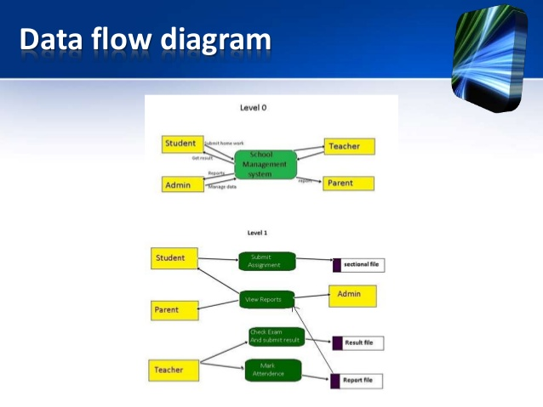

Slide 10
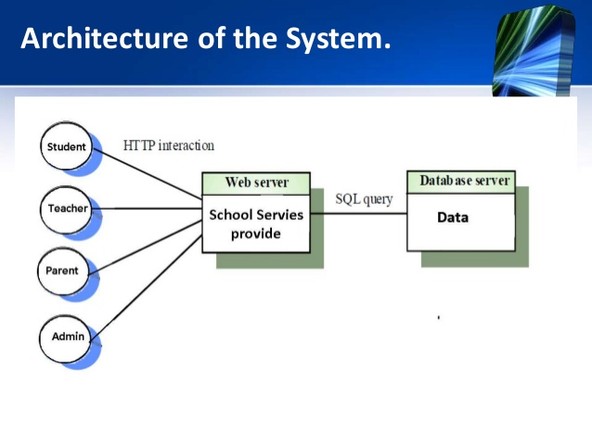

Slide 11
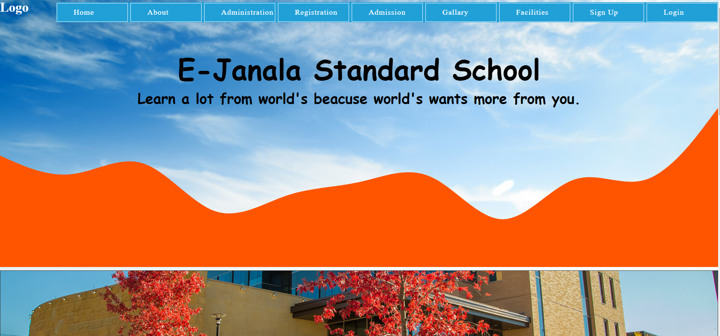
Interface Design

Slide 12
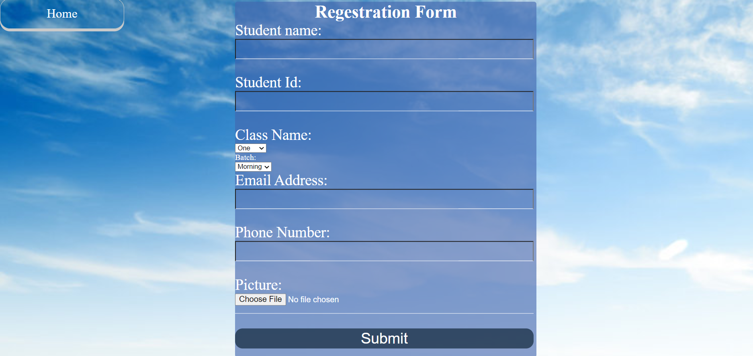

Slide 13
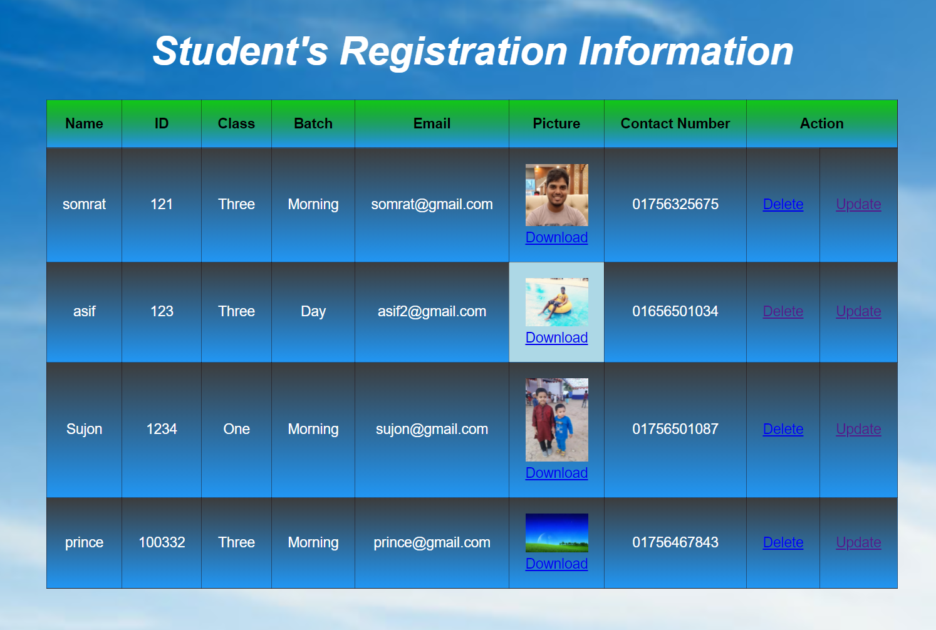
Interface Design

Slide 14
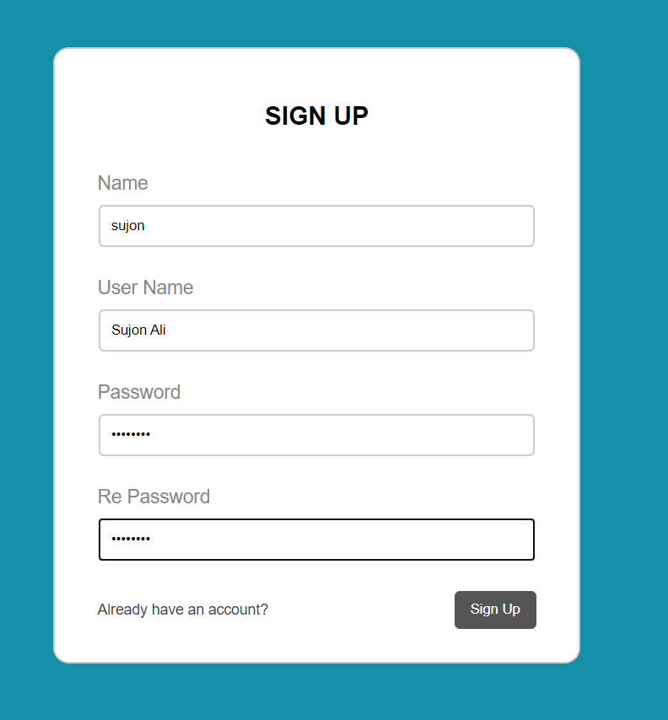
Interface Design

Slide 15
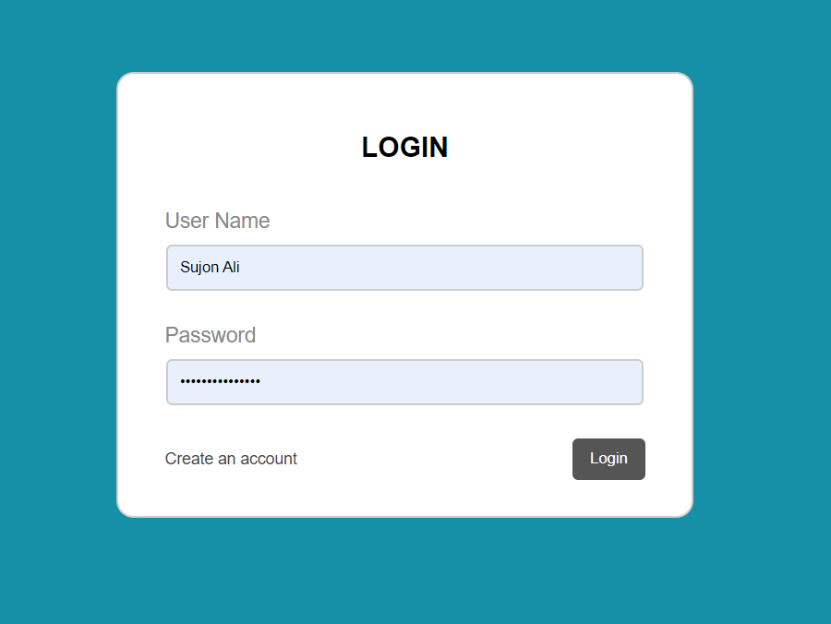
Interface Design

Slide 16

Interface Design

Slide 17
Benefits
Effective communication between teachers, parents and students
Complete automation of all operations
Centrally stored information with zero redundancy
Frequent interaction with teachers
Reliable update on child's attendance, progress report and fee payment.
Tracking of homework assigned by teacher to their child
Prior information about school events and holidays
Automated student attendance
Computerized management of marks and grades
Homework assignment to students and approval
Enhanced interaction with teachers, parents
Online submission of homework
Access to attendance, timetable, marks, grades and examination schedule
Prior information about school events and holidays

Slide 18
This application Growing Hopeful for my Web Application.
Conclusion:

Slide 19
Future Planning
Admin shall generate time table.
Student shall submit assignment online.
Online exam
Others

